Slide 1

CSC3007 information visualization Milestone one
Group P1 - 2:
Lim Chye Ya
Benedict Lee
Areeve Gam

Slide 2
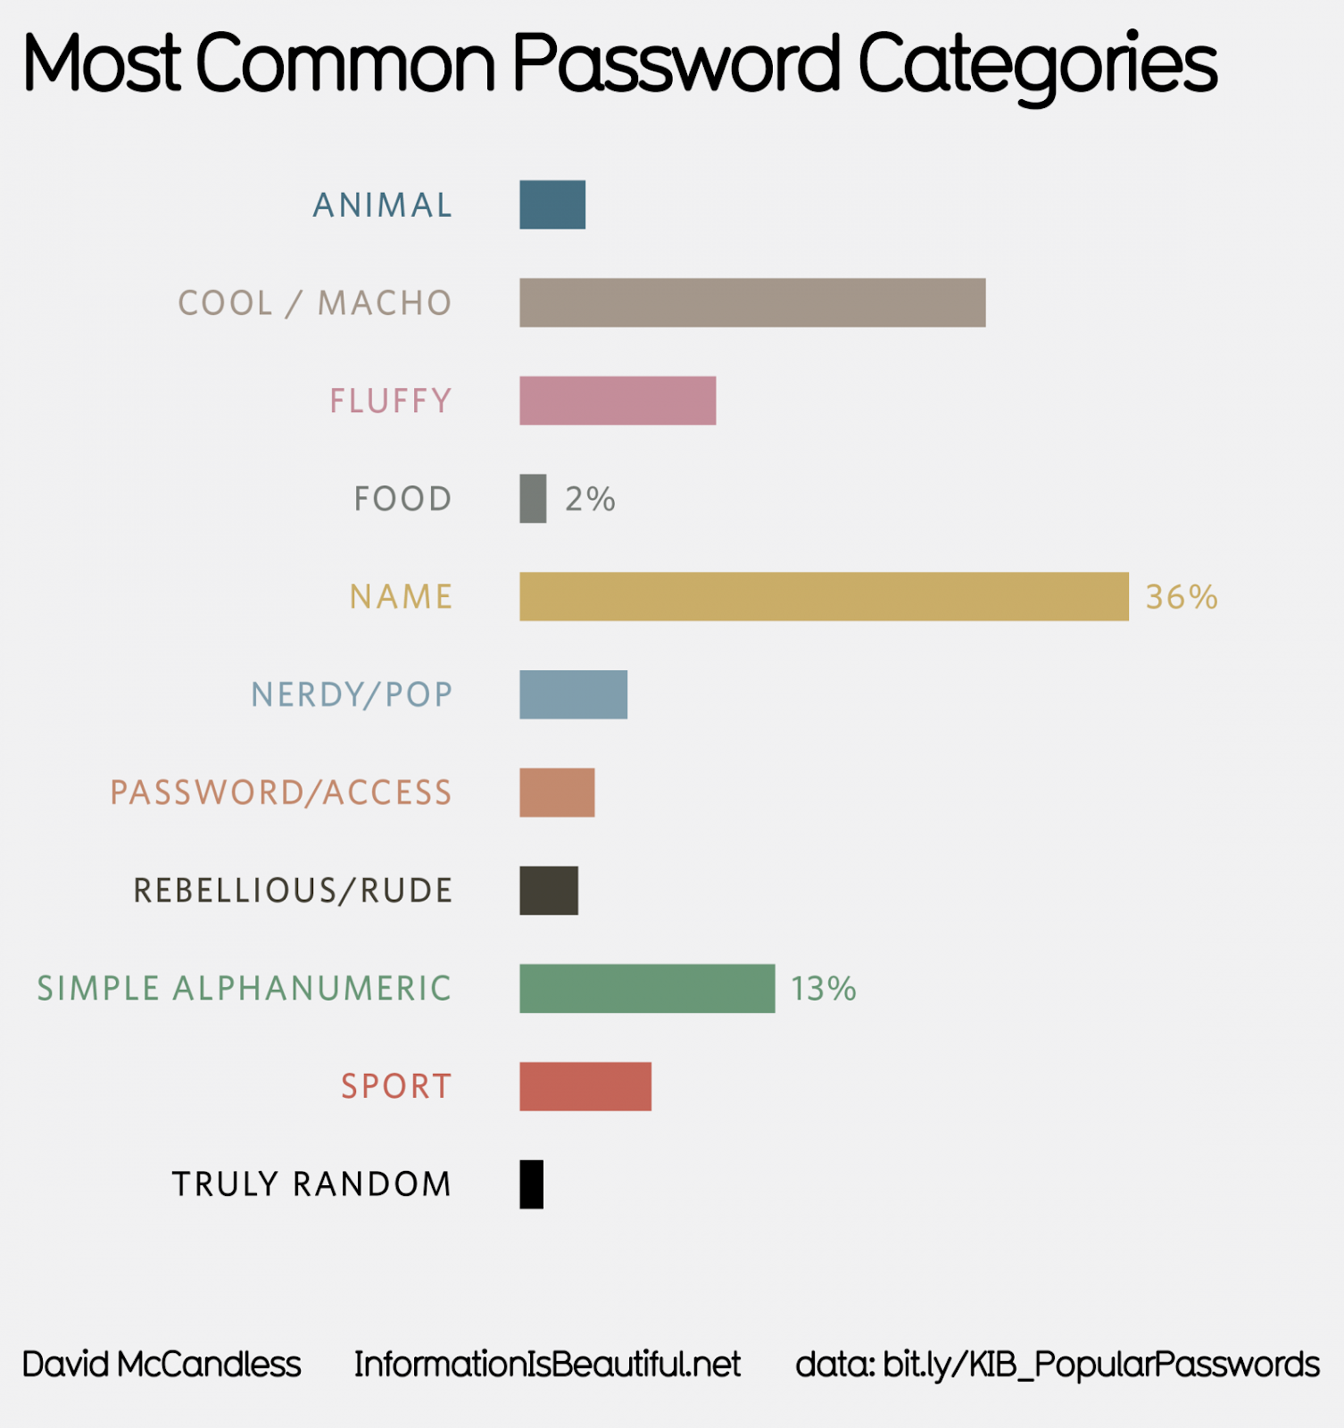
Visualization one
Notes:
https://informationisbeautiful.net/visualizations/top-500-passwords-visualized/
1. Evaluate the most common password
2. Educate user on security aspect when choosing an unique password

Slide 3
Data
Categories of Commonly Used Password
Percentage of Total Password Used in that category

Slide 4
Idiom
Horizontal Bar chart is used to show the common categories of password
Color is used to identify different category of the common password
Quantitative results uses percentages to indicate the number of frequently used password

Slide 5
Critique
Unable to identify the weightage between category without the frequencies (Truly Random & Food)
Colour Scheme used is similar leading to confusion (Truly Random & Rebellious)
Some categories contains sub-categories (i.e nerdy/pop)

Slide 6
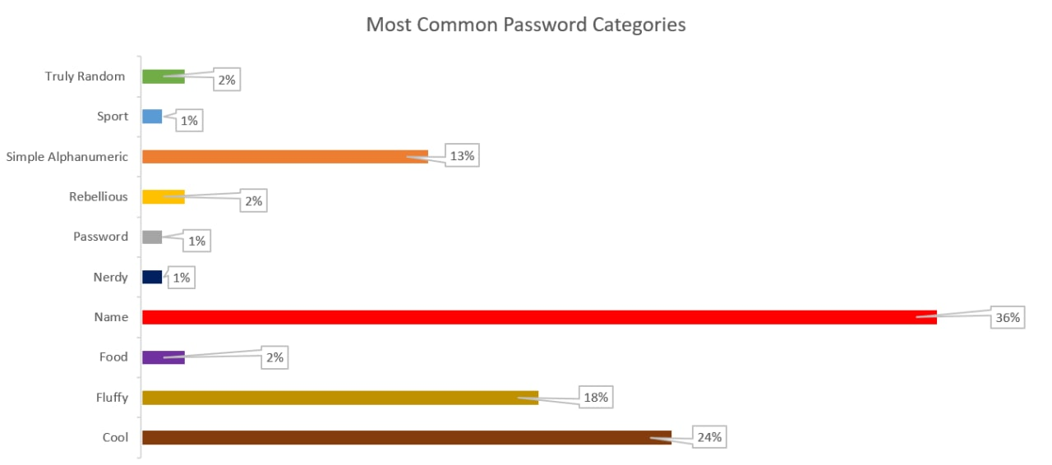
Visualization one: suggestion

Slide 7
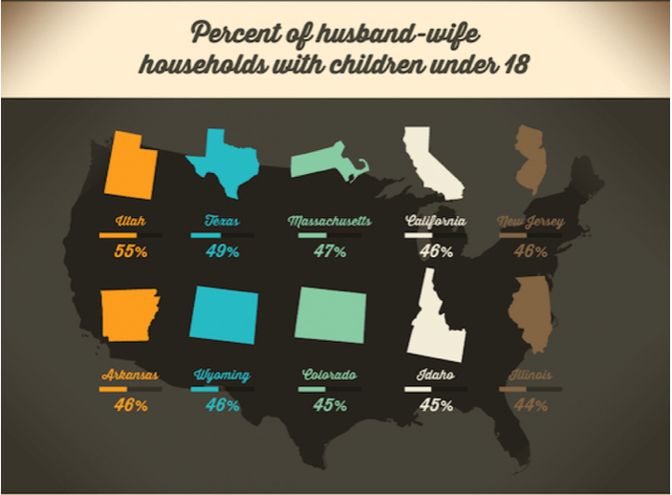
Visualization two
Notes:
https://visual.ly/community/Infographics/home/whos-living-together

Slide 8
Data
Percentage of Husband Wife Households with children under 18
Different States are represented on the map

Slide 9
Idiom
Percentages to represent the percentage of Husband Wife Households with children under 18
Horizontal Bar Chart to represent the percentage of Husband Wife Households with children under 18
Outline of the States to represent various states in the US

Slide 10
Critique
Not all 50 states are represented
One colour represents two states, violate the colour channel principle
Wyoming & Colorado have the same outline
All the bar graphs look similar

Slide 11
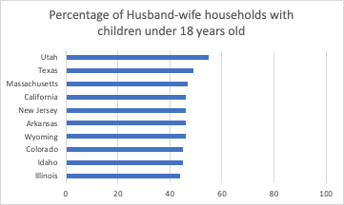
Visualization two: suggestion

